Slide 1


Gaming the System
Thomas Kelly
Notes:
Hi, I'm Tom Kelly, from ScottLogic and ShinobiControls!
Most of my work is iOS Development, with a splash of UX...

Slide 2
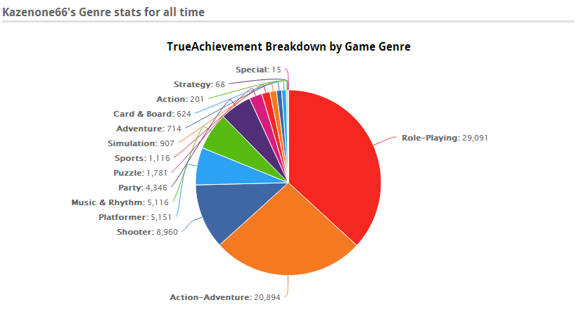

Gaming the System
Notes:
...and this is me outside of work!
As you can see, I play a lot of video games, and I've had a few side projects studying the mechanics of video games, and trying to make my own.
A lot of the mechanics of games can be boiled down to core components which slot together, but not all of them have to be within video games.
I'm going to talk about Gamification! So to start with, what is Gamification?

Slide 3
Gamification
“The application of typical elements of game playing to other areas of activity, typically as an online marketing technique to encourage engagement with a product or service.”
  Oxford English Dictionary
Notes:
Well the OED defines it as <read from slide>. There are two key points here. Firstly, the “typical elements of game playing”, which I'll come to in a minute, but also to “encourage engagement”.
Put more simply, “to motivate”. So what motivates people? Oversimplifying a bit, but there are two classes of motivation, which have different effects on people.

Slide 4
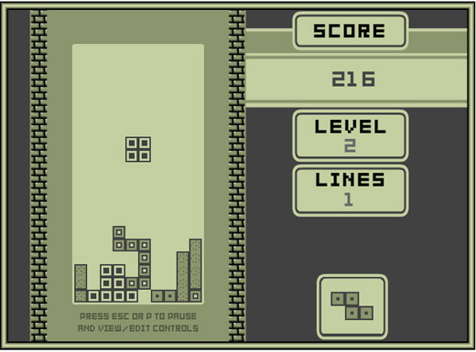
Internal Motivation
Score
Leaderboards
Achievements
Challenges
Plot
Notes:
Firstly, there is intrinsic or internal motivation; motivation from within, usually from interest and enjoyment of the topic.
This is a very powerful motivating factor, but also very fragile and tempermental. It doesn't take a lot to make someone get bored of a subject and lose interest if circumstances change.
In video games, these can be things like Points and Leaderboards; a desire to be the best. These are especially prominent in “never-ending games”, like Tetris on the right.
Achievements and Badges can also provide some bragging rights, and quantifiable rewards for people to aim towards, usually just as bragging rights. When done well, these can match up with challenges. “Deus Ex: Human Revolution” as an example had achievements for completing the game on the hardest difficulty, completing without killing anybody, and completing without setting off alarms. Some truly insane gamers also tried to do all of these in one playthrough.
The plot can also be a very engaging part of a game, as the player becomes curious about whats going to happen next.

Slide 5
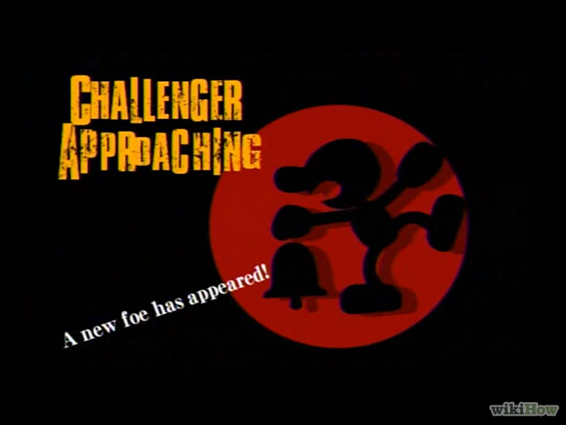
External Motivation
Unlockable Content
Experience Points
Level Up
Failure Mechanics
Notes:
The flipside of the motivational coin is External or Extrinsic motivation. These are motivating factors from outside, and are less fragile than internal motivation. However, they also tend to be less effective, and can even be demoralising if there is no internal motivation to back it up.
In games, this might be things like unlockable content and levelling systems (which might unlock some new content or abilities). The promise of punishment or failure is also a good motivation to succeed, if the punishment is effective enough.
Games can have some overlap between internal and external motivation. For example, scores can be gained from experience points, which in turn give levels up. Likewise, content can be unlocked by progressing with the Plot.
So how does this apply to the real world?

Slide 6
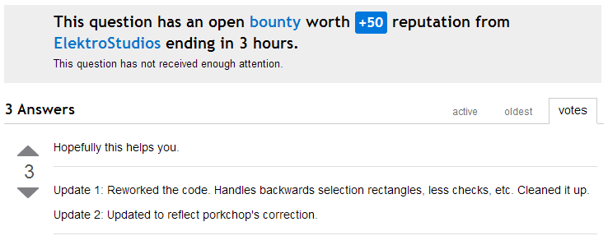
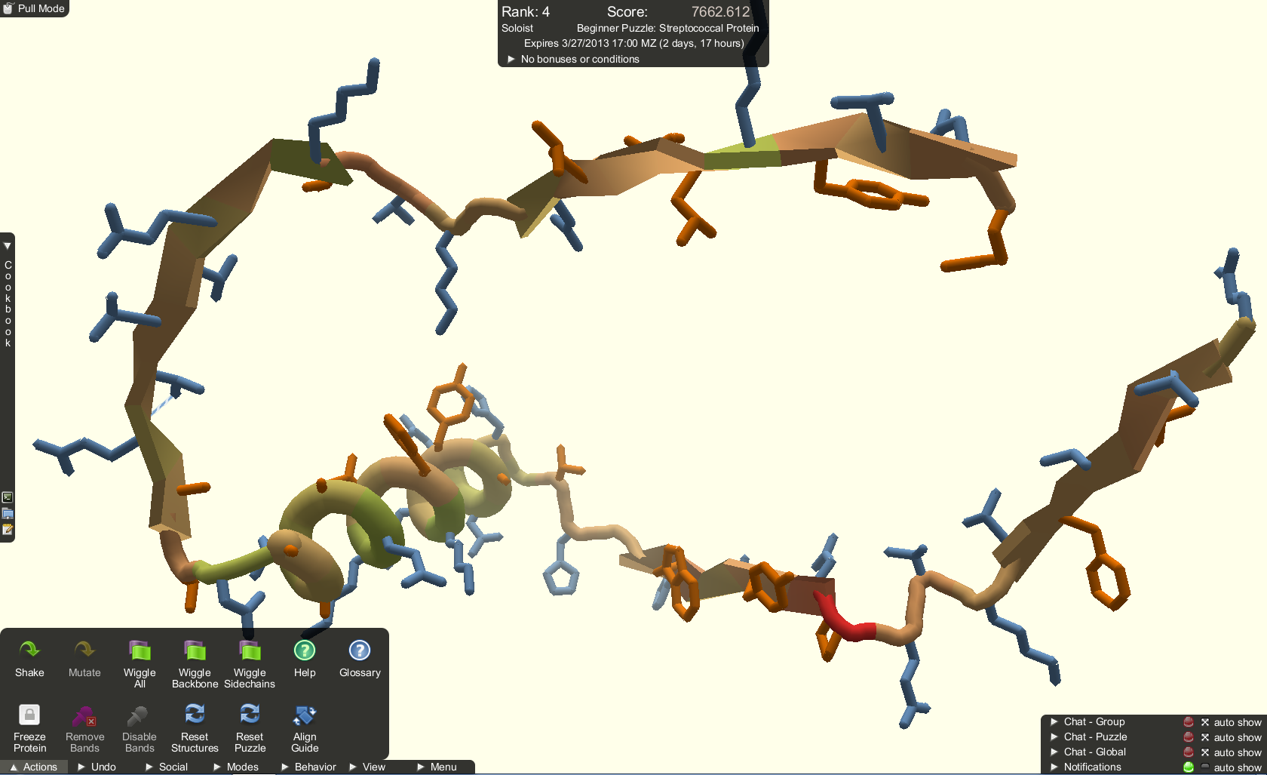
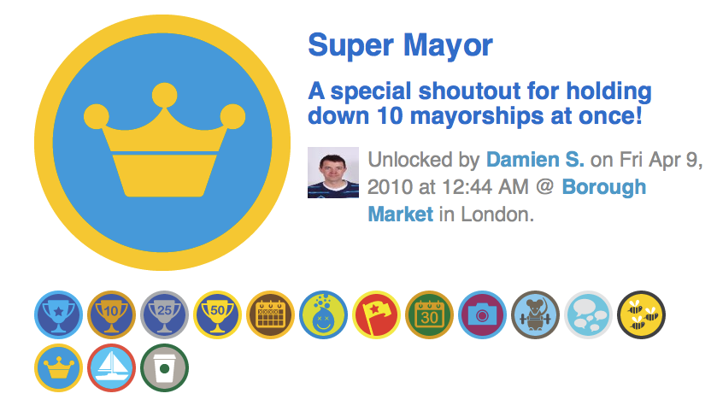
Gamifying the World
Notes:
So here's a few examples you may or may not recognize!
The top-left is Stack Overflow, where submitters of good questions and answers are awarded with points and badges, and can even donate those points as bounties to attract people to their questions. The bounties are only awarded to one answer, so players compete to be the top respondent.
Below that is Foursquare. In this, players check-in at various locations, and the most frequent player for a location becomes the mayor. Sometimes this is just a title, but some places give real rewards for their mayor, encouraging the mayor to spend a lot of time there. Starbucks, for instance, offer a free drink on Wednesdays, and some stores will even greet their mayor as “Mayor”.
At the top-right is foldit. The string of proteins shown is M-PMV, an AIDS-causing monkey virus. Scientists had been trying for 15 years to discover the shape of the molecule, before it was added to foldit. Over the cause of 10 days, 46,000 players (many of whom had no formal training) discovered the shape of the molecule through crowdsourced collaboration.

Slide 7
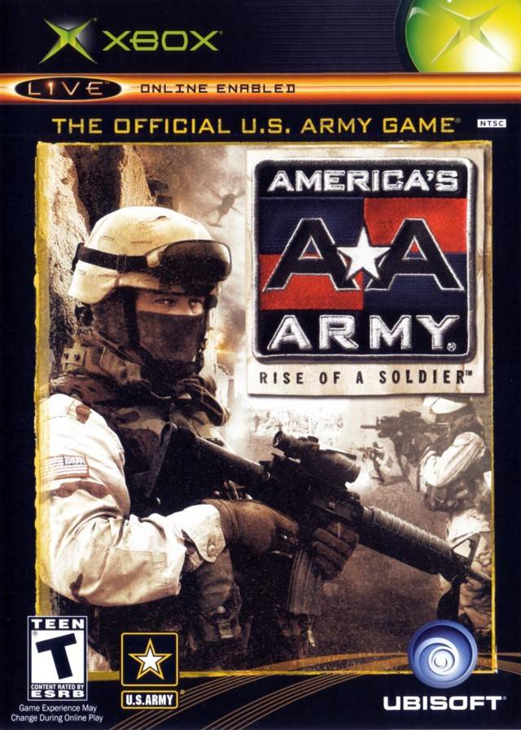
America's Army
Notes:
One example of gamification which turned into a full AAA game, from the US Military. Developed by Colonel Wardynski, it helped provide information to prospective soldiers on how the US Army really works, and helped reduce the number of recruits who left in the earliest stages of training.
To do this, they filled the game with lots of factually accurate information about tactics and training.
Of course, this is also a very powerful marketing tool for the Army, given that almost 13 million players have registered the game, and clocked more than 260 million hours of gameplay.

Slide 8
The Continuous Integration Game
Breaking the build (-10)
Breaking a broken build (0)
Build with no test failures (+1)
New test failures (-1 each)
New passing tests (+1 each)
github.com/jenkinsci/ci-game-plugin
Notes:
So these examples show the basic ideas, but here's an idea you can implement easily, with the aim of improving your test coverage.
This plugin to Jenkins games the build itself, encouraging tests to be written and checked, as well as checking the build builds in the first place.
Each commit is scored, and that score given to any committers in the build. A leaderboard is generated, showing who has been doing the most testing on their new code.

Slide 9
When it doesn't work
Meaningless rewards
Difficult Gameplay
Choosing the wrong metric
Notes:
By now, you might've noticed a theme from the successful examples; Collaboration or Competition between members.
When these this factor is missing, games tend to fail. Back in 2011, Google added badges for reading Google News. When reading through an article, you might earn a badge on your profile!
Two problems came out of this; Firstly, it was unclear how badges could be earned. There were rumoured to be 500+ badges to earn, but no official list of badges or methods to obtain was available.
More critically though, the badges were meaningless. Once you had a badge, you didn't have access to new content on your profile, and couldn't trade them for anything, they were just there.
The feature ended up being so unpopular that Google removed it in late 2012.
So some players might not enjoy your game, which is bad enough, but choosing the wrong metric to measure can be even worse.

Slide 10
Gaming the System
“When a measure becomes a target, it ceases to become a good measure.”
  Goodhardt's Law
“The more any quantitative indicator is used for social decision-making, the more subject it will be to corruption pressures, and the more apt it will be to distort and corrupt the social processes it is intended to monitor”
  Campbell's Law
Notes:
If your metric is important, and you gamify it, things can go very wrong. Especially when technical minds are involved.
Technical minds are very good at analysing the system, and finding the best way to exploit it to their own gain, which can involve playing the game differently from how you wanted.
Two similar quotes here, <Read quotes>.
So, for example, you could set up a bonus at the end of each month for the team with the least bugs picked up in QA. For a while, bug counts start to go down, but some teams realise that asking QA to inform them of bugs a little while before filing them into the system can give them a chance to reduce their count, without reducing the bugs.
Likewise, with the Jenkins plugin mentioned before, a committer could add a bunch of useless tests, such as testing each new getter and setter. They get points for each test they write, but the quality of the tests is much lower. Hopefully, this would be picked up in an intermediary code review, but you can see the effect if it wasn't.

Slide 11
The Magic Bullet
Notes:
So... Whats the magic bullet to improve your system through gamification?
Well... there isn't really a single magic bullet. Gamification, like all software practices, is a toolbox which can be applied to a project. Some tools may do the job better than others, but there is no requirement to use any single tool.

Slide 12
Summary
Gamification is hard to get right
If done right, is highly rewarding
Don't make anything too important depend on it
Focus on Collaboration and Competition, not Badges and Points
Notes:
To wrap up, Gamification is hard. Picking the right tool for the job requires a lot of analysis of the problem space, as well as trying to work out how it might be used or misused.
It can significantly boost user involvement though if done right, as seen by some of the earlier examples like Foldit and America's Army.
It can also seriously damage your systems if done wrong, so don't apply it haphazardly.
Finally, if nothing else, focus on teamwork or competition, instead of meaningless points and badges.
Thank you. Any questions?

Slide 13
Questions?
Slides: github.com/tpkelly/gaming-the-system

Slide 14
Gamifying Education
New Grading System
Experience Points and Levels
Bonus Achievements
Mini-games
Notes:
One other area which is getting huge amounts of input is Education.
Getting kids to care about Advanced Calculus and Geography can be a bit difficult to do if they are just handed a textbook. Great teachers are seen as ones who get people involved and motivated to learn, and this can be where gamification comes in.
I'll link to a video on the next slide as a great crash course in some ideas if this is your area of interest, but its a bit long to show in this presentation.
As some cliff notes for it, the current grading system has kids thinking their work is worth an A+, and only going downhill from there, instead of kids starting from a certain xp level, and gaining xp from their work. In particular, the best systems will have the students collaborating and competing against eachother to gain experience points.
Mini games can also help encourage students to read around the subject area, not just the syllabus topics, increasing understanding instead of just memorizing facts.

Slide 15
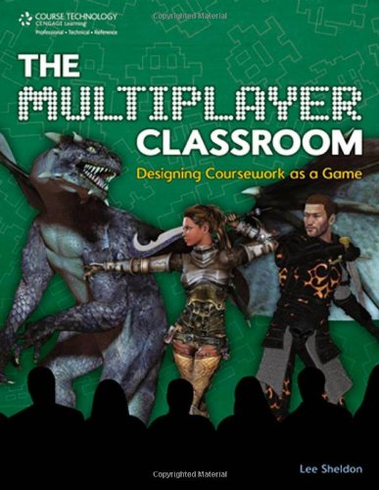
Gamifying Education
The Multiplayer Classroom
  Lee Sheldon
Extra Credits:
  youtube.com/watch?v=MuDLw1zIc94
Notes:
There are plenty of great resources out there for gamifying education. The video I mentioned before is from the “Extra Credits” team, while the book on the right provides a much deeper look into how these concepts can work.

